Slide 1
Sustainable Eating during the COVID-19 period
Dr. Priyadarshini Mallick,
Assistant Professor, Dept of Microbiology
Asutosh College, Kolkata
Member of Governing Body, Dhruba Chand Halder College, Dakshin Barasat

Slide 2
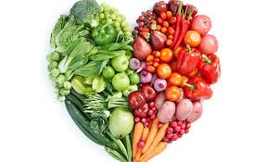
Concept Defined
Sustainable eating involves selecting foods that are healthy for our bodies, mind as well as the environment.
In this case, sustainable eating provides a balanced diet for the body from limited resources but also facilitates the conservation of the environment.

Slide 3
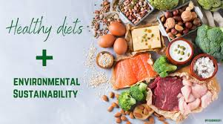
Eating Sustainably
No restriction on intake of green vegetables, fruits, fresh milk products.
Avoid powdered milk products as much as possible.
Beef, red-meat, bacon and ham should be readily avoided since they would add no health benefits rather can become expensive both economically and clinically.
There is absolutely no restrictions on butter, ghee, cheese , cottage cheese, etc.

Slide 4
Eating Sustainably
During this period small edible fishes can add to your nutrition level at the same time is often pocket friendly.
Intake of wheat products should be appropriate as fibre is an essential warrior for your immune system.
Not restricting your protein source such as chicken, fish and legumes can help to add omega-3 fats, omega-6 fats, and antioxidants to the body which is the need of the moment.

Slide 5
Eating Sustainably
Plant-based foods have been demonstrated to be healthier as compared to animal-based options.
Green chilies can act as an essential source of antioxidant for your system.
Atleast thrice a week, try and include leafy vegetables to add anti-inflammmatory sources in your diet.
Include curry leaves in cooking because it can help in treating dysentery, constipation and diarrhea since availing a doctor on call is difficult now.
Pudina leaves if included in diet would add phytonutrients and menthol, which enhances digestive enzymes.
Finally papaya leaves can be consumed in the form of juice since it has numerous benefits like treats dengue fever, has anti-malarial properties, enhances liver function, supports digestion, lowers blood sugar level and cures menstrual pain.
Soya in all forms is a cheaper and adequate source of protein.

Slide 6
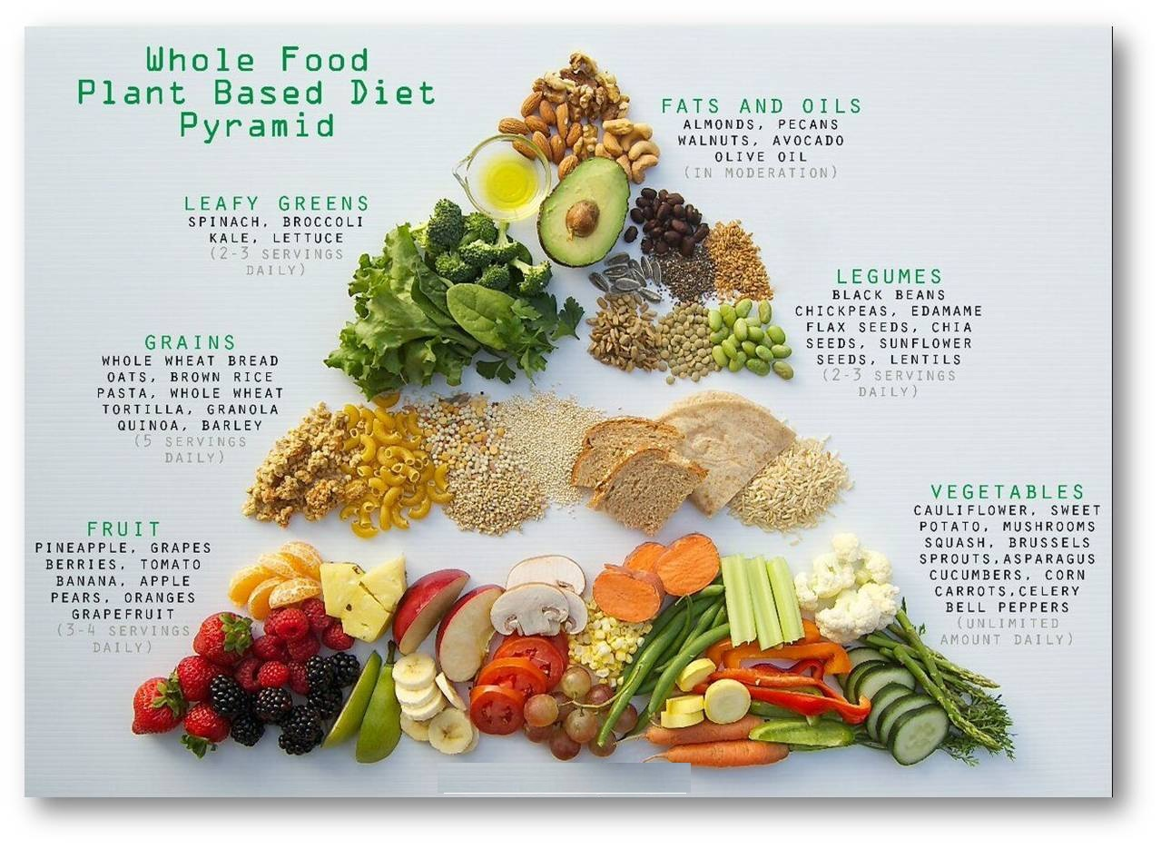

Slide 7

Growing your own Food
Carbon Emission: When someone grows own food, it means that it helps cut down the food transport cost over long distances using vehicles that release emissions into the environment.
Secondly, since we are all at home to fight this deadly virus lets contribute some oxygen to the environment by growing edible plants.
Finally, your own kitchen garden can be your own choice-able resource where you can help your neighbors' too.

Slide 8
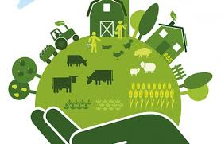
10 ways that consumers, food producers and legislators can work together to make the food system more sustainable.
Local eating
Encourage cooking
Design menus to follow seasons
Rotate crop varieties regularly
Waste less
Support Fair Trade
Consider food’s true cost
Invest financially
Avoid additives, pesticides and go organic
Be willing to forgo convenience
Eat Well, Live Well

Slide 9
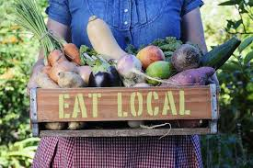
Local Eating
When a person buys food from local farmers, he/she is contributing to the community’s economy and also decreasing the impact on Mother Nature. Another upcoming worldwide economic depression would want us to act accordingly.

Slide 10

Encourage Cooking
Cooking at home is essential practice of people that encourage controlling over own food to be consumed.
It can eliminate ingredients like added sugars and fats. This, in turn, creates a healthier community , avoids making ourselves junk reservoirs and keeps fast food away.

Slide 11
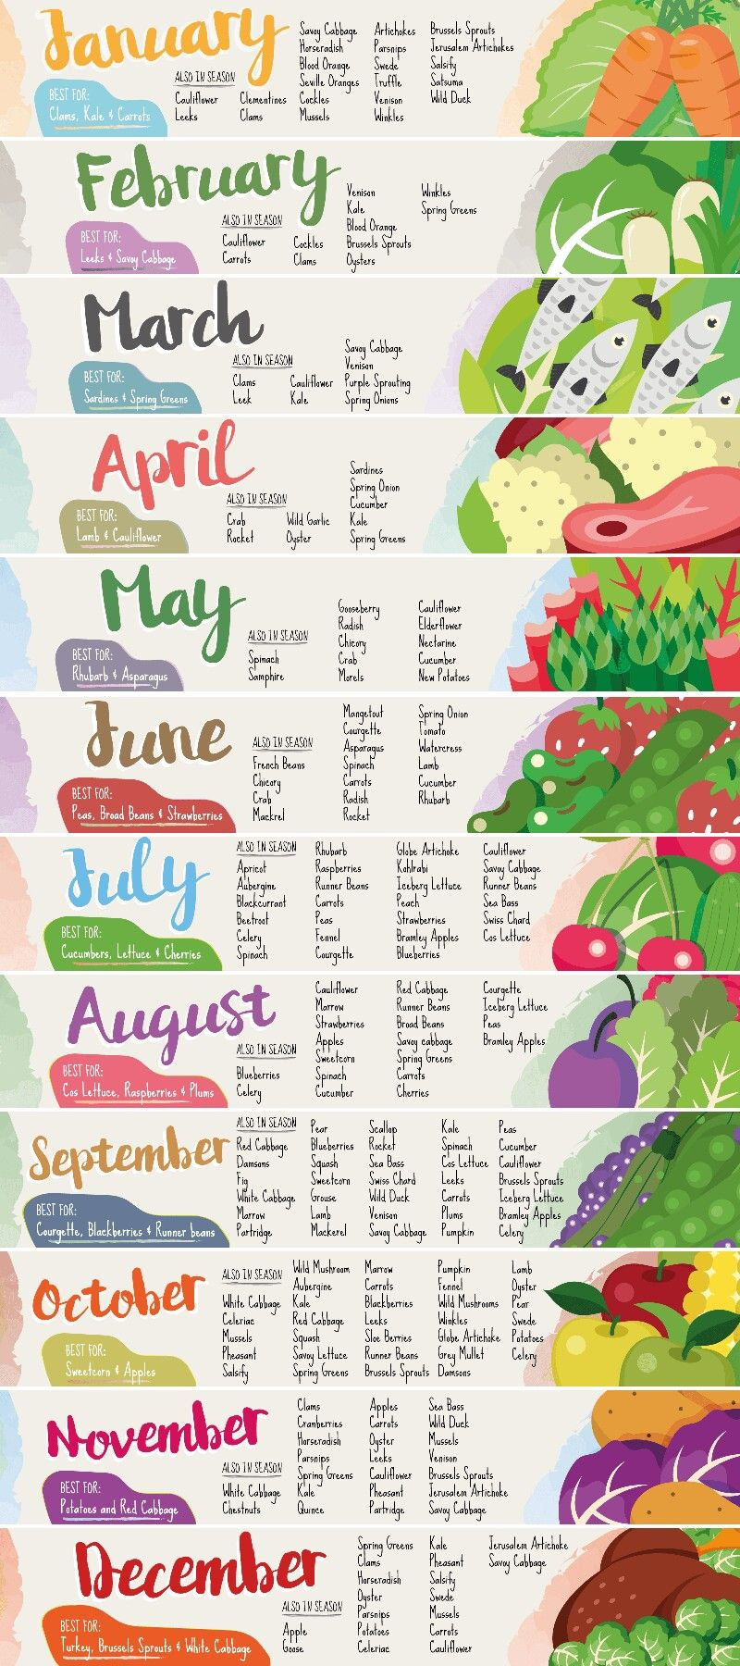
Designing Menus to follow reasons
Designing menu with seasonally available ingredients and products is a pivotal aspect
The choice of food and its ingredients can have a big impact on environmental footprint.
There are many lenses through which one can look at food options including: local, organic, seasonal, and water-wise.
Eat root vegetables and hearty greens in the fall and winter. Eat salads, fruit, and tomatoes in the summer. Even expensive cooking oils can be replaced by palm oil since they devour health benefits.

Slide 12
Sustainable Food and Benefits
Fresh, healthy and better tasting food​
Fewer food miles, less transportation, less pollution
Ensuring the survival of tradition, sustainable production method​s to be employed
Preservation and protection of local landscape​
For example : we can use red spinach instead old imported spinach or ice-berg lettuce. ​

Slide 13
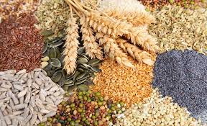
Introducing Super Grains​ In Culinary
Super grains is a term used for grains which confer health benefits resulting from an exceptional nutrient density.​
Super grains are rich in fiber resulting in better digestive system and stronger immune system.​
Super grains includes: quinoa, poppy seed, buckwheat, amaranth​.

Slide 14
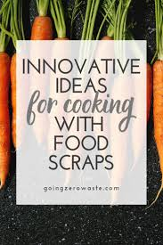
Taste not waste/ Root to stem​
A concept, wherein no part of a vegetable is wasted as such.​
About 20% of a vegetable is wasted on an average as part of peels, tops, leaves etc.​
These wastes are being either used with the original vegetable itself, as a garnish or being pickled/fermented.​

Slide 15
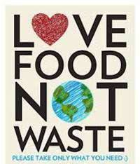
Eat what you Need
Millennial India is slowly and steadily advocating sustainable dining since it has become the utmost need of the hour.
Chefs are the most qualified people on the planet to talk about food, not only in terms of flavors, but also the chemistry behind the ingredients they use.
World legends spreading the mantra of sustainable food, like:
                Massimo Bottura
                Dan Barber
                Joan Roca
Implementing sustainable practices will ultimately improve the health of humans and the environment they live in.

Slide 16
COVID-19 Pandemic: Way We Eat
Expert predictions of how coronavirus will change the way we eat, based on recent surveys and forecasting:
Healthy and Organic Eating will become increasingly important
Increasing value of healthy foods such as fruits and vegetables
There will be reduced demand for exotic foods
Significant decrease in demand for exotic animals and their products.
There will be greater focus on eating local
Increase demand for food from community-supported agriculture and local farms will be more in practice

Slide 17
The food industry will take a different shape post the COVID-19 outbreak
The entire culinary world will perceive a new future.
The industries will look for new opportunity in which the sustainable dining will play as protagonist in the entire global culinary show.
Important Tips:
Chewing fresh basil leaves helps fight depression which we all are more or less victim.

Slide 18
" EAT FRESH
KEEP HEALTHY
STAY HOME
SAVE LIVES”
.....................Nature

Slide 19
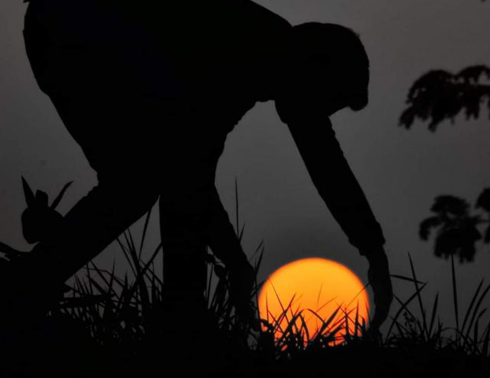
THANK YOU

