Slide 1
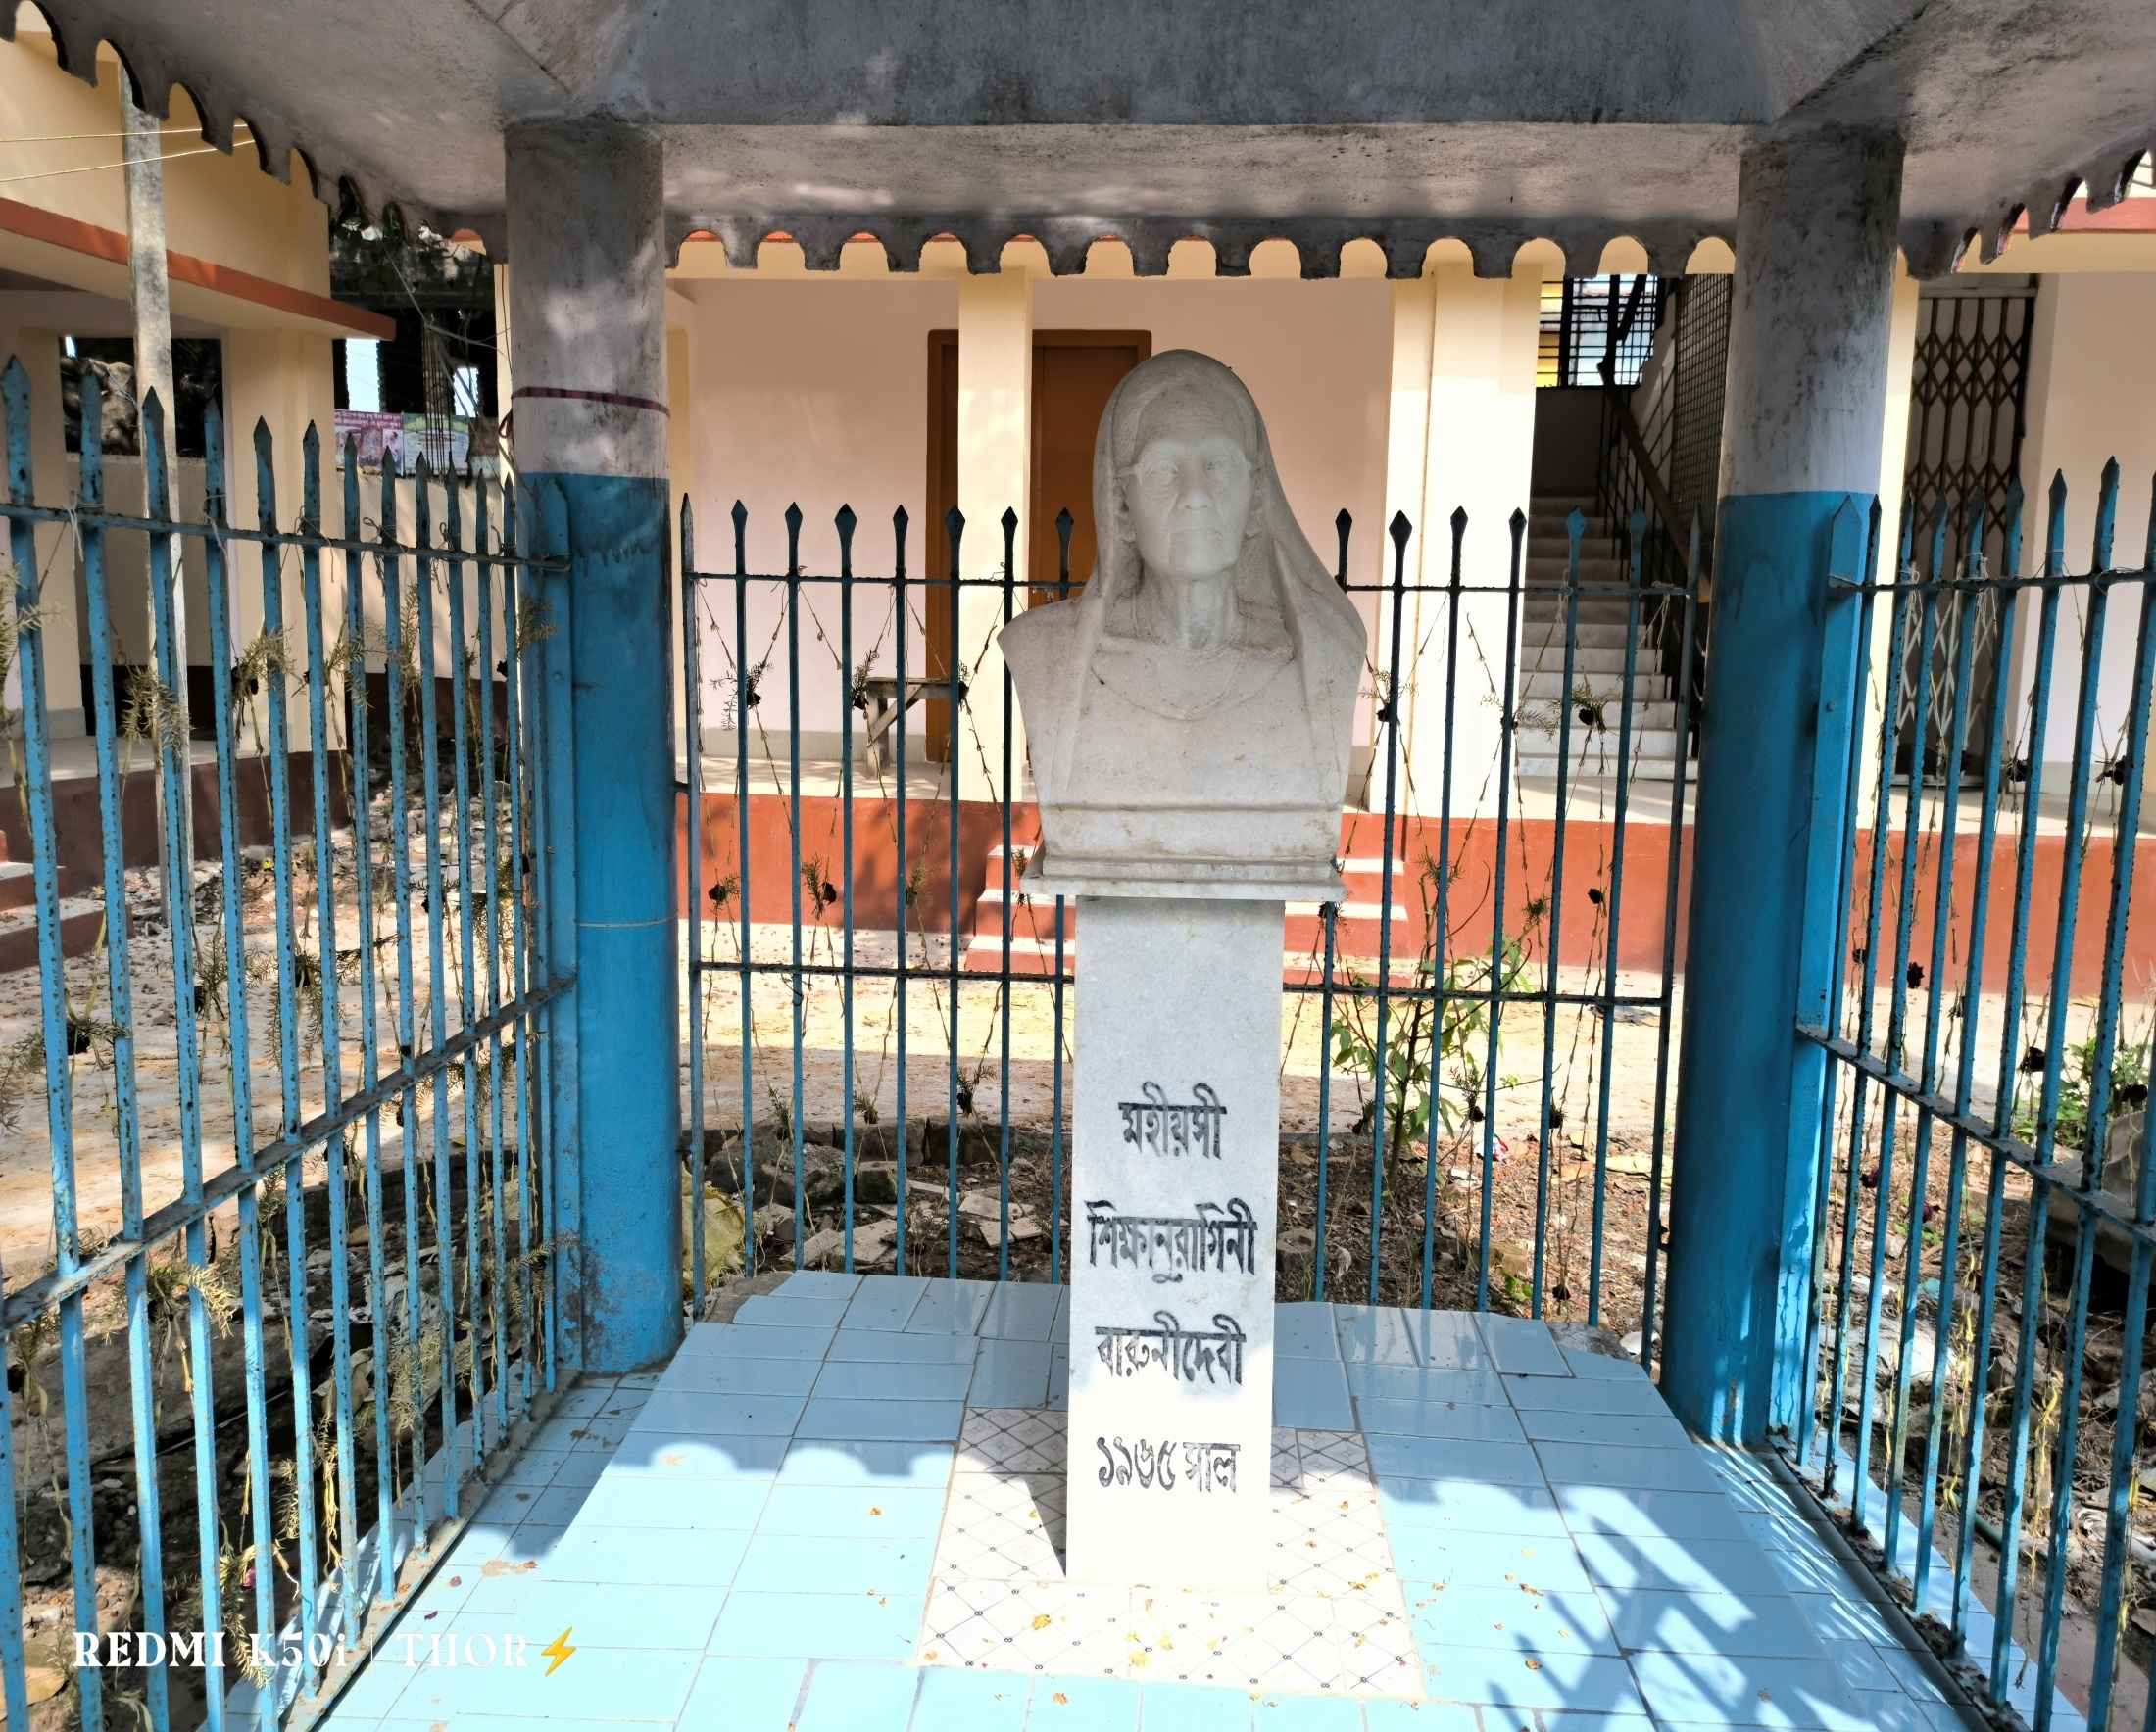

DHRUBA CHAND HALDER COLLEGE
Department of Microbiology
In Collaboration with IQAC
Organizes - “ BARUNI DEVI MEMORIAL LECTUURE ”
On 13th December 2022 Tuesdayat12noon
Speaker: Swami Ekachittananda Maharaj Principal of Ramakrishna Mission Residential College.
Title of Talk: স্বামী বিবেকানন্দ ও বর্তমান যুবসমাজ।
Venue: Auditorium of Sailendranath Bhawan,
Dhruba Chand Halder College
ALL MEMBERS OF THE COLLEGE FAMILY ARE CORDIALLY INVITED.

